Slide 1


Java Native GPIO Operations Using Device I/O API
What is IoT, RaspberryPi and Lab to build a Candy Vending Machine

Slide 2

About me…
@jeffprestes
Developer Advocate Java, PHP, JavaScript Developer

Slide 3
Agenda
What is not IoT
What is IoT
Polymath required skills
Small history of RaspberryPi
RaspberryPi Components and slots
Raspbian – a Debian/Linux to RasberryPi
Java support to SOC devices
Java Device I/O
Lab
Configure WiFi network (static / dhcp / resolv.conf)
Upgrade the Raspbian
Install WiringPi
Install Java for Embedded devices

Slide 4
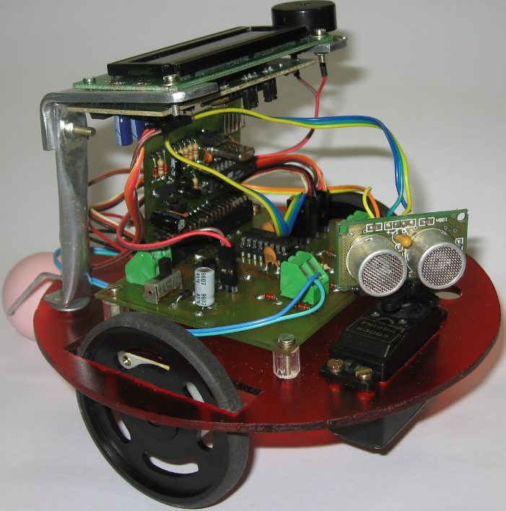

This is not IoT… (IMHO)
This is so cool but this is Eletronic!!

Slide 5



And this is not new…
(who has gray hair can say… P)

Slide 6
What is IoT?
Internet Million of Web Services (PayPal, Twitter, Google, Netflix, Facebook)
Things Billions of sensors, motors, displays, appliances, toys, cars, stores, robots
+

Slide 7

And to work with IoT you’re going to need more skills
You’re going to need to a Polimath
A polymath (Greek: πολυμαθής, polymathēs, "having learned much")[1] is a person whose expertise spans a significant number of different subject areas; such a person is known to draw on complex bodies of knowledge to solve specific problems. The term was first used in the seventeenth century; the related term, polyhistor, is an ancient term with similar meaning. (Source: Wikipedia - http://en.wikipedia.org/wiki/Polymath)

Slide 8




Italian Polymath. What was da Vinci? Scientist? Engineer? Mathematic? Painter? Sculptor? Musician? Botanic? Anatomist? Source: Wikipedia - http://en.wikipedia.org/wiki/Leonardo_da_Vinci

Slide 9
Server Side
Client/Desktop
Eletronic (sometimes mechanic and sculptor on wood or iron)
Mobile (Beacons e Weareables)
Operation Systems

Slide 10


Slide 11
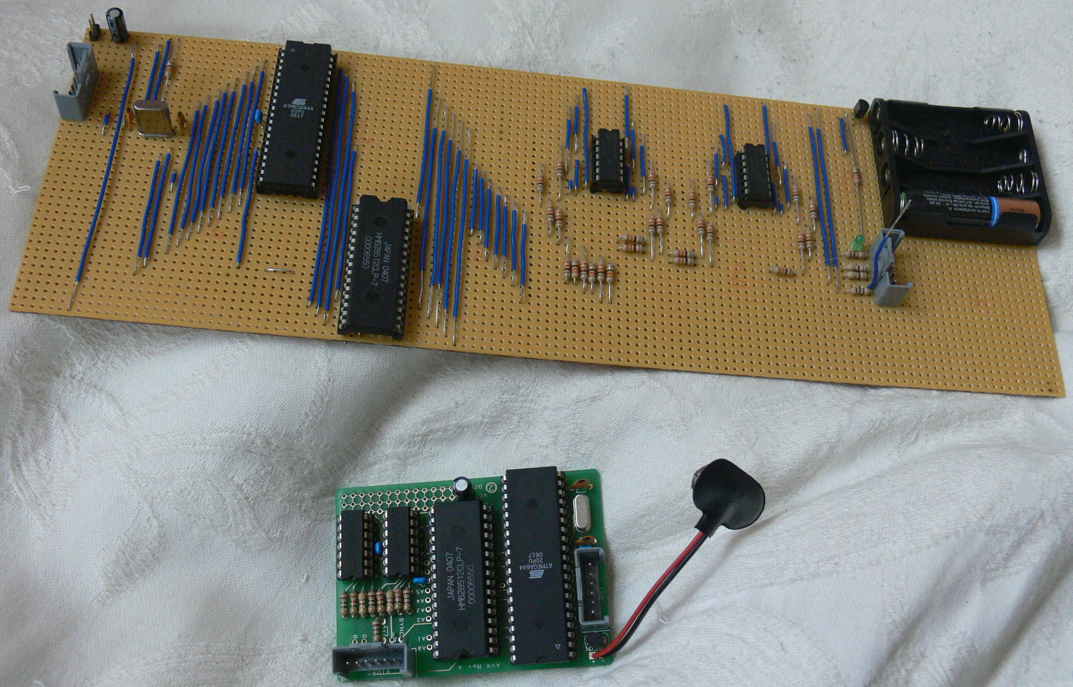
History
Designed in UK, University of Cambridge, 2006, to be a chip alternative to computers to students. Also a way to students rediscover how cool is to work with Robotic. It has been projected to educational purposes but can used in Commercial ones too.
Team that have concepted it: Eben Upton, Rob Mullins, Jack Lang and Alan Mycroft
Raspberry Pi Foundation was created and first alpha boards were tested, 2011
Sells begins April, 2012
Model B+ is released in November, 2012
More than 5 Million already have been sold

Slide 12
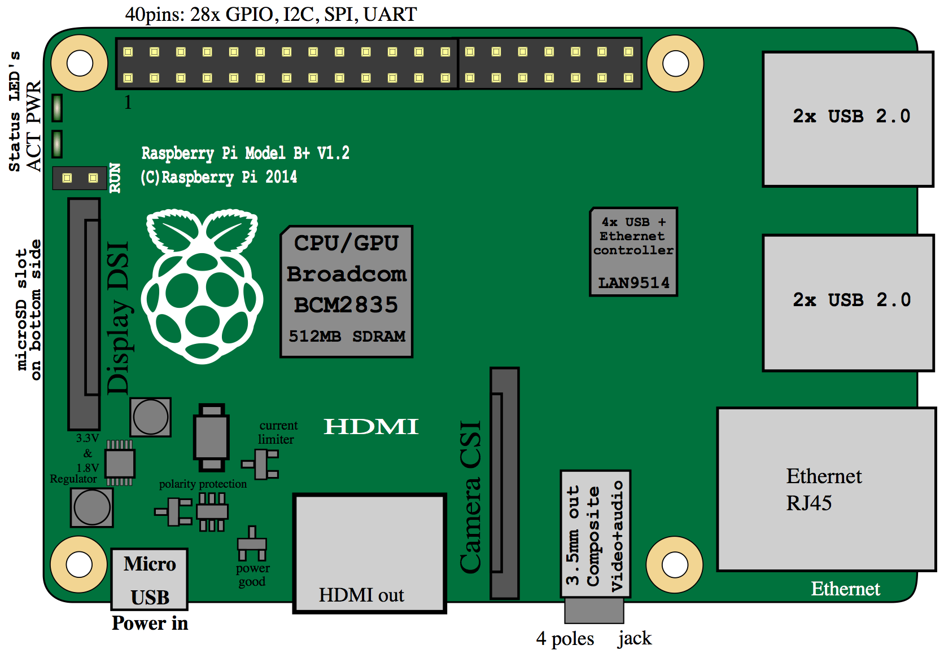

Slide 13

Raspbian is an unofficial port of Debian Wheezy armhf with compilation settings adjusted to produce optimized "hard float" code that will run on the Raspberry Pi.
Best OS to Raspberry Pi nowadays. If you use Ubuntu, you’re going to feeling in home. All basic Unix commands works on it and almost all basic server-side too: Apache, Nginx, PHP, Java, Python, MySQL
To install it in your MicroSD card (Recommend 8Gb or more) http://www.raspberrypi.org/documentation/installation/installing-images
Default user: pi / Default password: raspberry And never forget: sudo apt-get install and be happy :D
Note: Raspbian is not affiliated with the Raspberry Pi Foundation. Raspbian was created by a small, dedicated team of developers that are fans of the Raspberry Pi hardware, the educational goals of the Raspberry Pi Foundation and, of course, the Debian Project.

Slide 14
JDK SE for Embbeded Devices
Since JDK 7, Java SE SDK for Desktop was ported to ARM chips and JDK 8 is already available.
As Raspberry Pi is based in a ARM chip and runs over a Linux distribution you’re able to use Java SE
You can run your favorite Java Application Server or create JavaFX applications
(you don’t need to learn JME or Python anymore :D!)

Slide 15
Device I/O API
Originally part of Java ME library, The Device I/O project is an open source, Java-level API for accessing generic device peripherals on embedded devices based on JavaSE. It’s under OpenJDK project.
https://wiki.openjdk.java.net/display/dio/Main
http://docs.oracle.com/javame/8.0/api/dio/api/index.html

Slide 16
Differences between Device I/O and PI4J
PI4J is an excellent API, however it’s only for RaspberryPi if you would need to run your APP into a BeagleBone board will have to rewrite all GPIO access code.
Device I/O, as other Java API, brings abstraction layer over GPIO access functionallity saving your time and complexity. Write once run anywhere :D

Slide 17
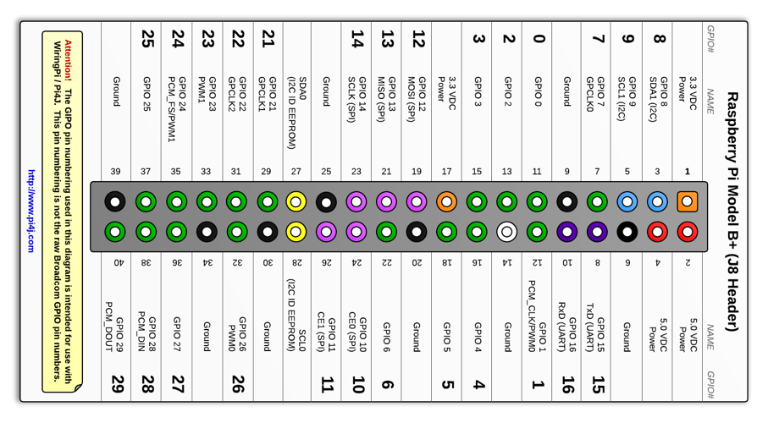
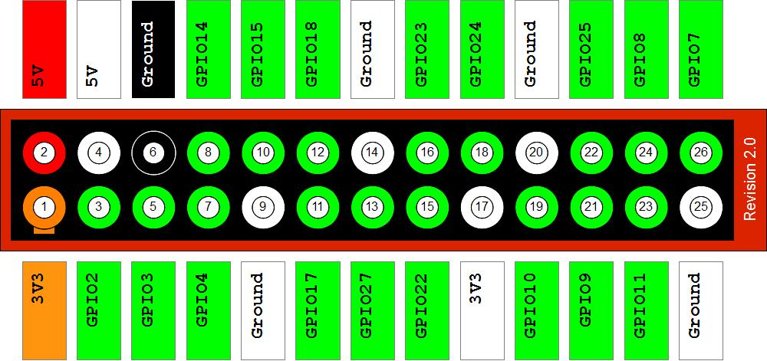
Differences between Device I/O and PI4J
Also, GPIO map is different in two APIs, check:
Device I/O
PI4J
http://docs.oracle.com/javame/8.0/get-started-rpi/piportsapdx.htm
http://pi4j.com/pins/model-b-plus.html

Slide 18
Device I/O API
Device I/O has a configuration file for each board
The Raspberry PI file is
dio.properties-raspberrypi
It has definitions for each GPIO ports
Thus Device I/O can works with different SoC Computers

Slide 19
Device I/O API
Device I/O requires special JDK permissions to access GPIO
Device I/O comes with gpio.policy file
You can map each Pin you’re planning to use or only:
grant {
permission jdk.dio.gpio.GPIOPinPermission "*:*";
permission jdk.dio.DeviceMgmtPermission "*:*", "open";
};
(okay, don’t do this in production kids)

Slide 20


Slide 21


Slide 22


Slide 23

Thanks.
Jeff Prestes
@jeffprestes
Slideshare.com/jeffprestes
Github.com/jeffprestes
@paypaldev
developer.paypal.com
developers.braintreepayments.com

Slide 24


Slide 25
Configure your wifi credentials:
sudo nano /etc/wpa_supplicant/wpa_supplicant.conf (file content below)
network={
ssid="iPhone"
psk="43070720"
}
network={
ssid=”<<your-wifi-name-here>>"
psk=”<<your-wifi-password>>"
}
network={
ssid="BoxNet"
psk="hackkitty"
}

Slide 26
Configure your wifi network using static IP:
sudo nano /etc/network/interfaces (file content below)
auto lo
iface lo inet loopback
iface eth0 inet dhcp
auto wlan0
allow-hotplug wlan0
iface wlan0 inet static
address 192.168.20.218
netmask 255.255.255.0
gateway 192.168.20.1
wpa-conf /etc/wpa_supplicant/wpa_supplicant.conf
iface default inet static

Slide 27
Configure your wifi network using DHCP (most used):
sudo nano /etc/network/interfaces (file content below)
auto lo
iface lo inet loopback
iface eth0 inet dhcp
auto wlan0
allow-hotplug wlan0
iface wlan0 inet dhcp
wpa-conf /etc/wpa_supplicant/wpa_supplicant.conf
iface default inet dhcp

Slide 28
sudo apt-get update
sudo apt-get dist-upgrade
//Upgrades Raspbian
sudo reboot //Use Reboot to restart Raspbian safetly
sudo halt
//Use halt to turn off Raspbian safetly

Slide 29
Configure the DNS Servers
sudo nano /etc/resolv.conf
(file content below)
nameserver 8.8.8.8
nameserver 8.8.4.4
//Google DNS servers

Slide 30
Wiring Pi
It is GPIO Interface library for the Raspberry Pi. It’s written in C for the BCM2835 used in the Raspberry Pi. WiringPi includes a command-line utility gpio which can be used to program and setup the GPIO pins.

Slide 31
Wiring Pi
Installation
$ sudo apt-get install git-core $ git clone git://git.drogon.net/wiringPi
$ cd wiringPi $ git pull origin $ ./build
Test
$ gpio -v
$ gpio readall

Slide 32
Get back to your user home directory
(in this case you’re using pi user, remember?)
$ cd ~/

Slide 33
Downloading JDK SE 8 for Embedded
I will have to download it from your computer as you will have to accept Oracle’s terms and conditions.
http://www.oracle.com/technetwork/java/javase/downloads/jdk8-arm-downloads-2187472.html
Mac and Linux users: use scp to copy the file
$ scp jdk-<version>-linux-arm-vfp-hflt.gz pi@<your-device-ip>:/home/pi/jdk-<version>-linux-arm-vfp-hflt.tar.gz
(note that I’ve changed the extention because the downloaded file came only with .gz extention)
Windows users: use WinSCP to do this

Slide 34
Installing JDK SE 8 for Embedded
At PI home directory execute:
$ sudo mkdir -p /opt/java
$ sudo chown root:root /opt/java
$ cd /opt/java
$ sudo tar xvzf ~/jdk-<version>-linux-arm-vfp-hflt.tar.gz
Set default java and javac to the new installed JDK. $ sudo update-alternatives --install /usr/bin/javac javac /opt/jdk-<version>/bin/javac 1 $ sudo update-alternatives --install /usr/bin/java java /opt/jdk-<version>/bin/java 1 $ sudo update-alternatives --config javac $ sudo update-alternatives --config java After all, verify with the commands with -verion option. $ java -version $ javac -version

Slide 35
Installing JDK SE 8 for Embedded
Double check if java version is correct for root too:
$ sudo java -version $ sudo javac –version
This is important because will you need to run your Java application that access GPIO with root privileges.

Slide 36
Installing JDK SE 8 for Embedded
Define JAVA_HOME environment variable:
$ sudo nano /etc/environment
And add to it:
JAVA_HOME="/opt/jdk-<version>"
Do the same in your bash profile
$ nano ~/.bashrc
And add to it:
export JAVA_HOME="/opt/java/jdk-<version>"
export PATH=$PATH:$JAVA_HOME/bin

Slide 37
Installing Java Device I/O
You’ll need to download and compile the library in your Raspberry PI.
Device I/O like other OpenJDK projects uses Mercurial to manage their source code. You must install it into your Raspberry PI
$ sudo apt-get install mercurial
Create a directory to store the source code and compile it
$ mkdir deviceio
Download it
$ cd deviceio
$ hg clone http://hg.openjdk.java.net/dio/dev

Slide 38
Installing Java Device I/O
Let’s compile it:
$ export PI_TOOLS=/usr
$ cd dev
$ make
After this, let’s install your Device I/O files in your JRE
$ cp -r build/deviceio/lib/*
$JAVA_HOME/jre/lib

Slide 39
Now let’s get started to talk about good things…

Slide 40


Slide 41
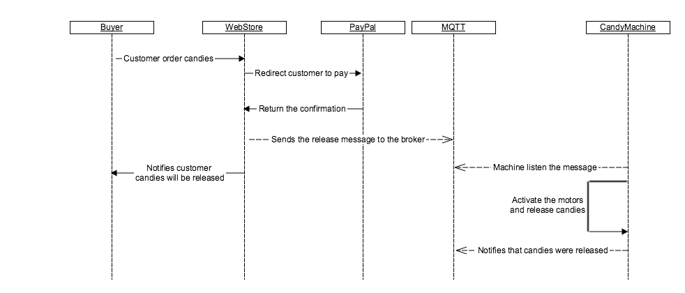
Our Lab: Create a Candy Vending Machine
How it works

Slide 42

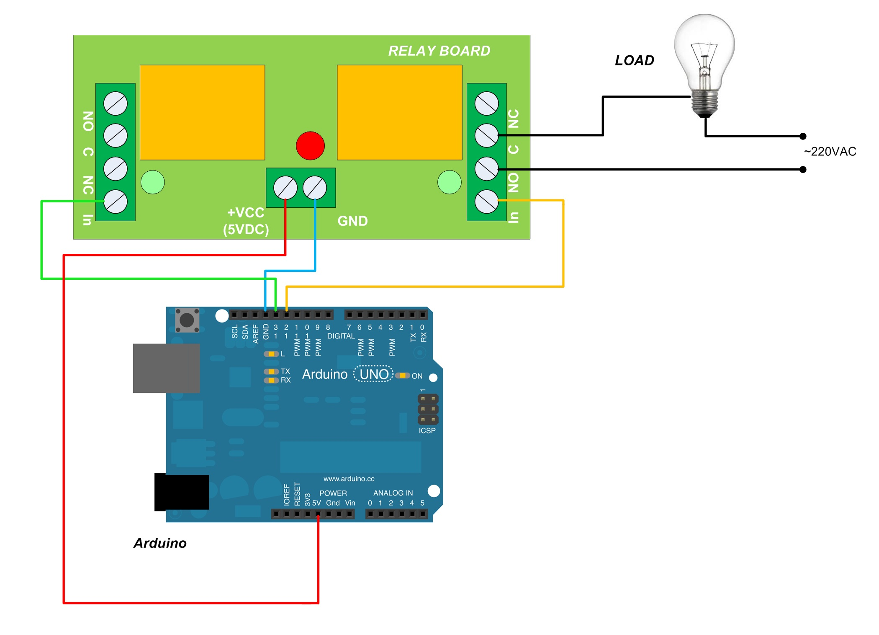
Our Lab: Create a Candy Vending Machine

Slide 43
Our Lab: Create a Candy Vending Machine
Let’s use Wiring Pi to test the circuits
$ sudo gpio mode 1 output
$ sudo gpio mode 4 output
$ sudo gpio write 1 1
$ sudo gpio write 1 1
$ sudo gpio write 1 0
$ sudo gpio write 1 0

Slide 44
Our Lab: Create a Candy Vending Machine
Copy the dio.jar compiled in your Raspberry Pi to your machine
$ scp ~/deviceio/dev/build/jar/dio.jar <your-user>@<yourmachineip>:~/dio.jar
Or use yout WinSCP
Add it your Maven local repository
$ mvn install:install-file -Dfile=~/dio.jar -DgroupId=jdk.dio -DartifactId=device-io -Dversion=1.0 -Dpackaging=jar -DgeneratePom=true
Open the Netbeans and at Team->Git->Clone Repository
https://github.com/jeffprestes/candies-client-native-java.git

Slide 45


Slide 46


Slide 47
Our Lab: Create a Candy Vending Machine
Copy the jar compiled with Dependencies to home’s directory of pi user.
Now it’s time to edit GPIO permissions in gpio.policy file
Copy it to home directory
$ cp ~/deviceio/dev/samples/gpio/gpio.policy ~/gpio.policy
And content must be like this
grant {
// permissions for using GPIO pin 18 GPIOLEDSample
permission jdk.dio.gpio.GPIOPinPermission ":18";
permission jdk.dio.gpio.GPIOPinPermission "0:18";
permission jdk.dio.DeviceMgmtPermission "GPIO18:18", "open";
permission jdk.dio.gpio.GPIOPinPermission ":24";
permission jdk.dio.gpio.GPIOPinPermission "0:24";
permission jdk.dio.DeviceMgmtPermission "GPIO24:24", "open";
};

Slide 48
Our Lab: Create a Candy Vending Machine
Now, let’s start the machine application
$ sudo java
-Djdk.dio.registry=/home/pi/java/dio/config/dio.properties-raspberrypi
-Djava.security.policy=/home/pi/java/nativegpio/gpio.policy
-jar candies.jar iot.eclipse.org jeffprestes/candies/world machineusa 1883
Where:
iot.eclipse.org is the MQTT server
jeffprestes/candies/world is the queue
machineusa is the client name
1883 is the MQTT broker port

Slide 49
Our Lab: Create a Candy Vending Machine
To buy
Create a Premier account in PayPal Sandbox developer.paypal.com -> Dashboard -> Sandbox -> Accounts -> Create Account
Later, goto candies.novatrix.com.br in your mobile phone and use this user as a buyer

Slide 50


Slide 52
Thanks.
Jeff Prestes
@jeffprestes
Slideshare.com/jeffprestes
Github.com/jeffprestes
@paypaldev
developer.paypal.com
developers.braintreepayments.com

